Slide 1
Introduction to EVA Arm
About application use please visit my website first:
http://www.tamashi.top:2000/#/york
Kinematics, Reverse Kinematics, Camera Calibration and application

Slide 2
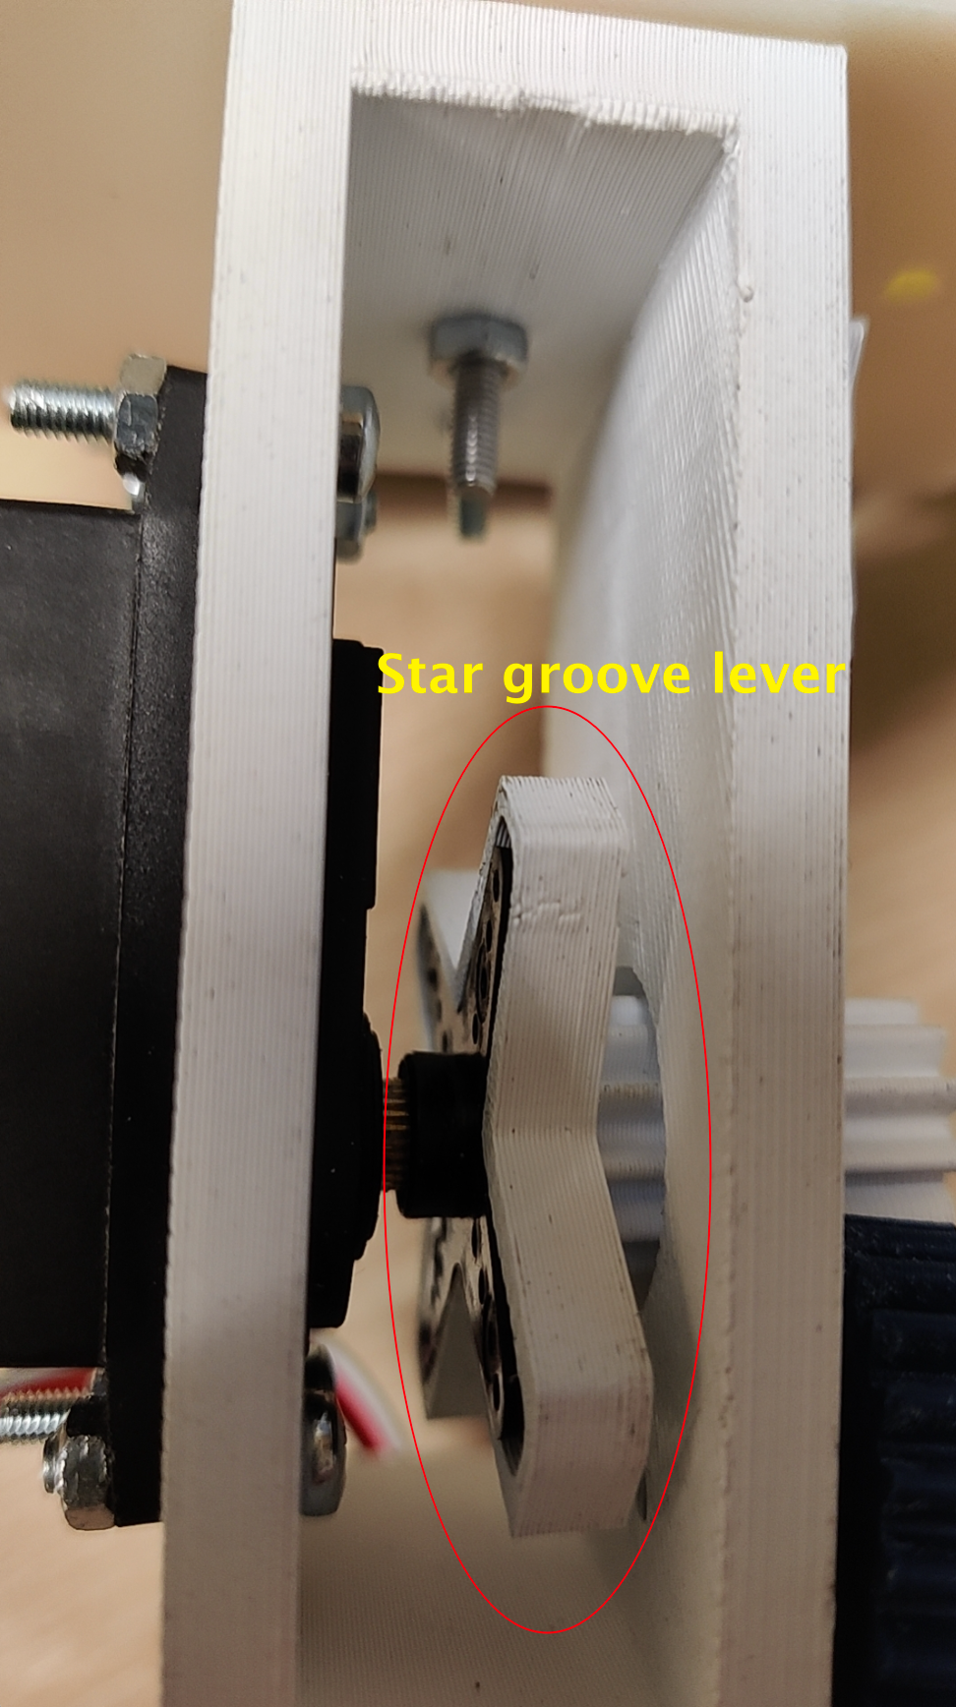
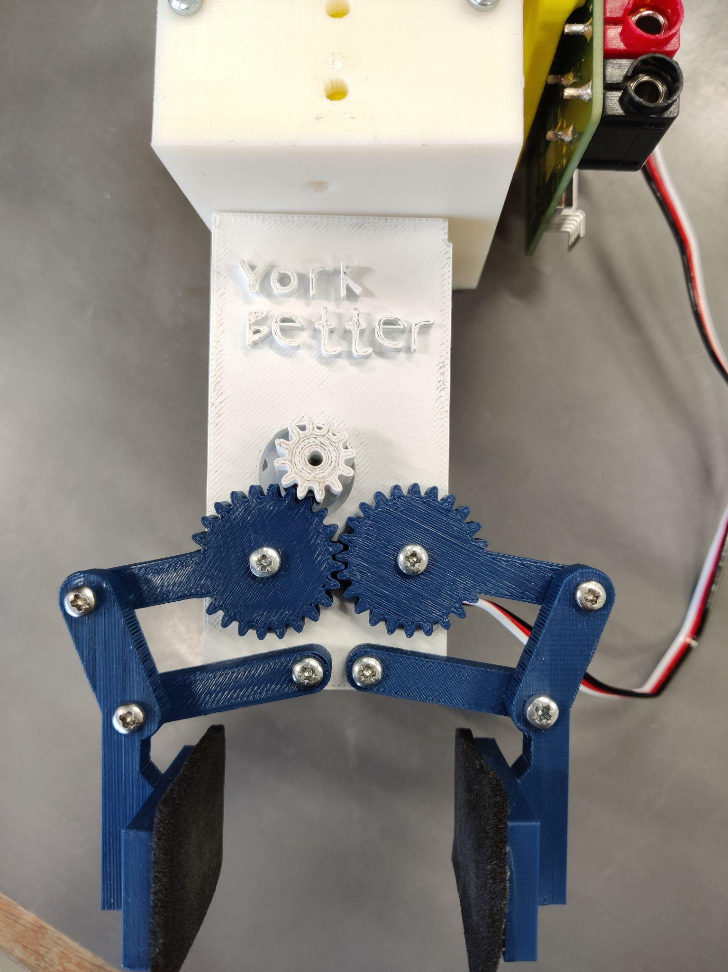
Arm Design
Photo by Pexels

Slide 3
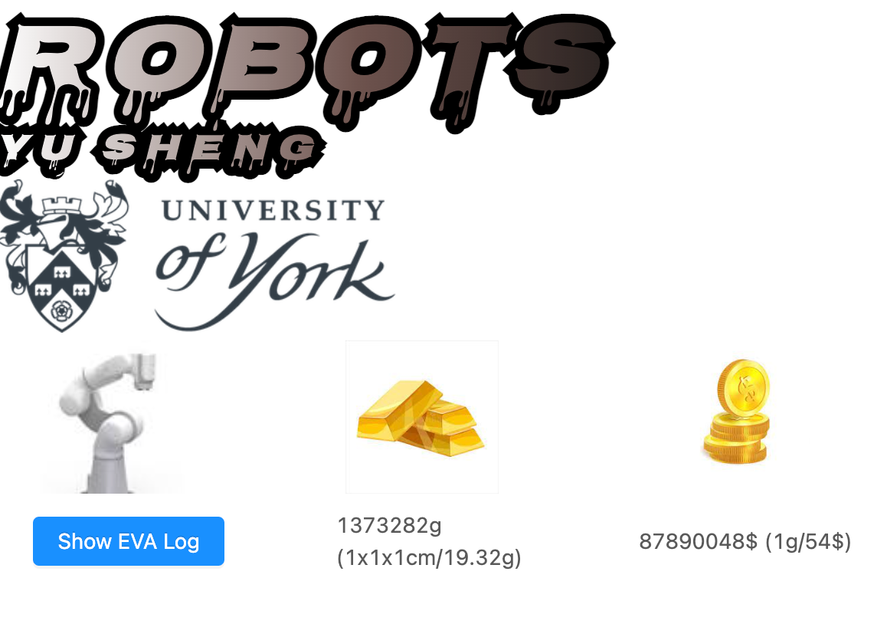
Mock Application - York testing ground for gold mining
Using EVA arm to find gold and catch
Estimate how much gold we find
Estimate how much money we made
Show EVA debug log for observation
http://www.tamashi.top:2000/#/york
Photo by Pexels

Slide 4
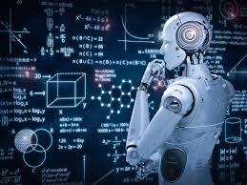



Software architecture
Backend and frontend separate architecture
Backend framework - tornado
Frontend framework - ES5(javascript) + react + css3 + html5
Photo by Pexels

Slide 5

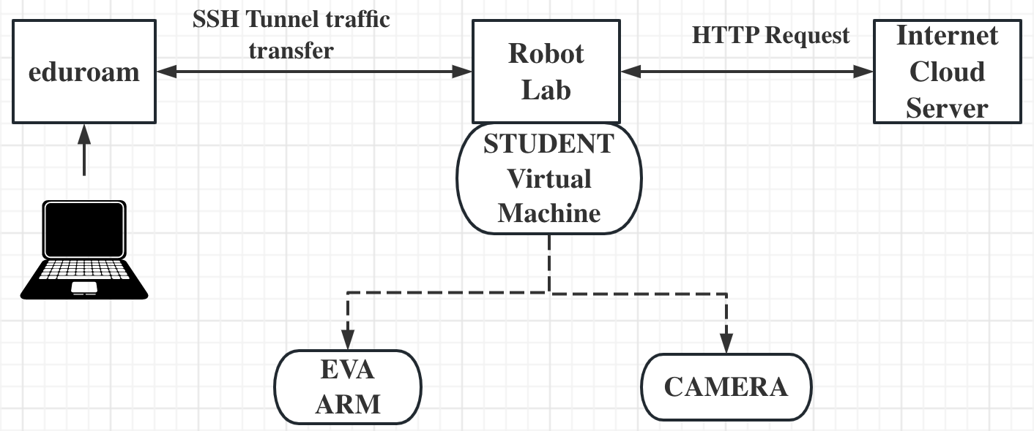
Network penetrate (remote working more efficient)
Wifi ‘robot lab’ is intranet, and eva arm can be controlled in Wifi ‘eduroam’ but camera not, and my website is on the internet. so 3 network penetrate design looks like:
Photo by Pexels

Slide 6
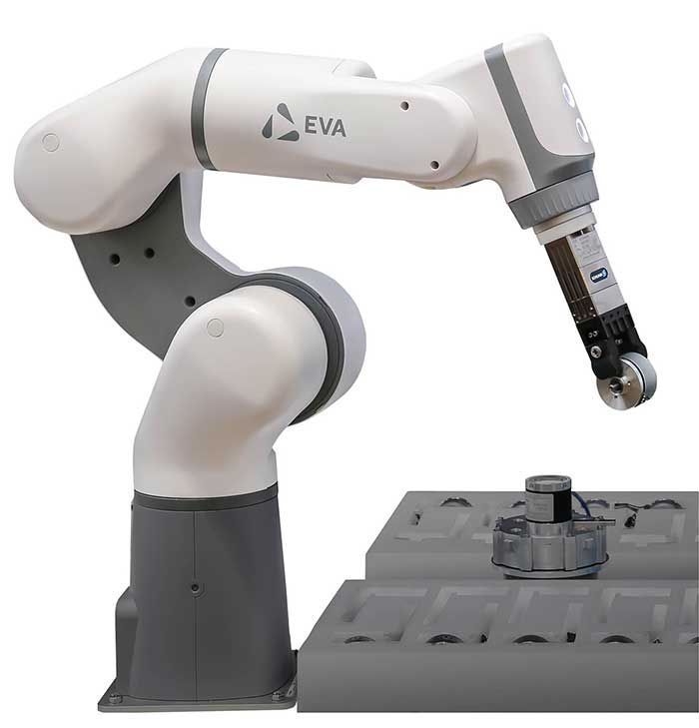
Types of Kinematics
Two main types: Forward and Inverse Kinematics
Forward Kinematics - finding end effector position and orientation

Slide 7
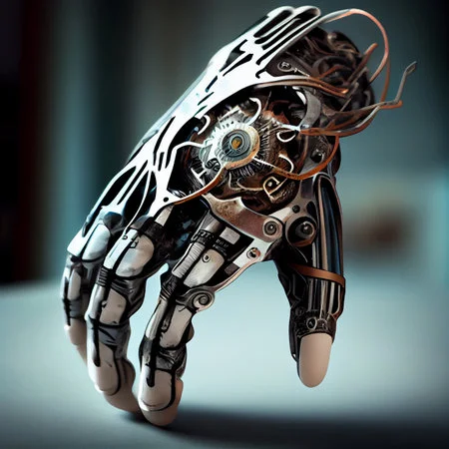
Reverse Kinematics
Inverse Kinematics - finding joint angles for desired end effector position
Jacobian Matrix for EVA Arm movement
Iterative Methods for Inverse Kinematics for EVA Arm

Slide 8
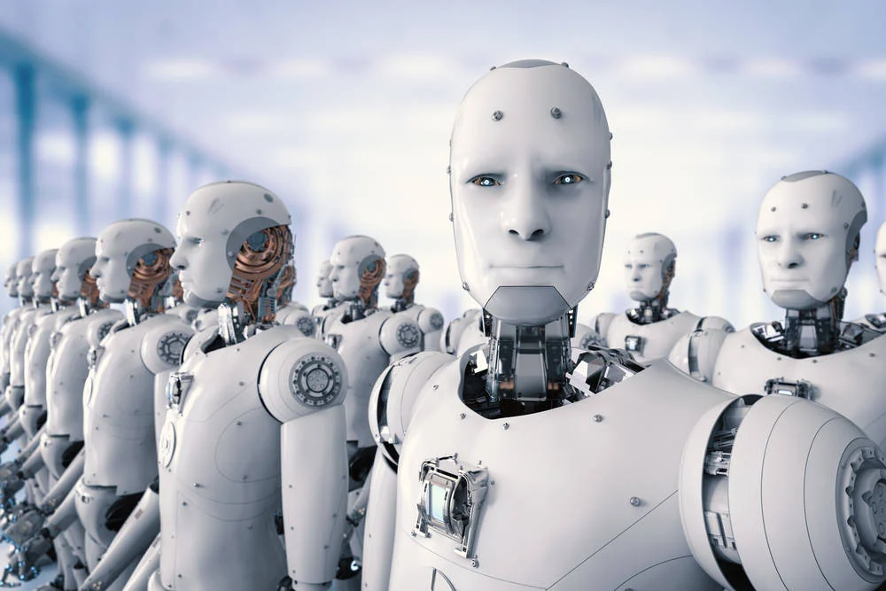
Iterative Methods for Inverse Kinematics
Trial and error for finding the optimum joint values
Uses numerical methods and algorithms for convergence
Important for EVA Arm manipulations
Improves performance and accuracy

Slide 9
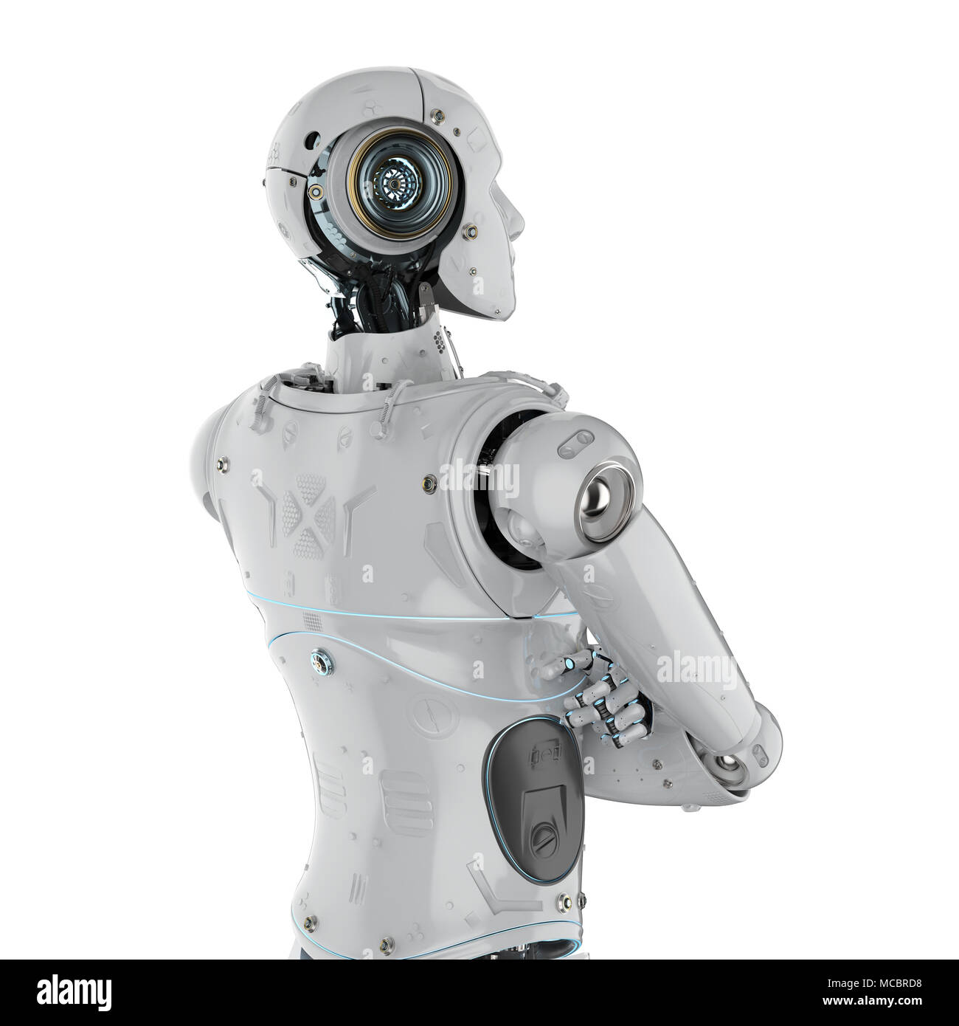
Importance of Kinematics and Reverse Kinematics for EVA Arm
Precise and effective movement of EVA Arm
Complete tasks with accuracy and speed
Saves time and reduces errors

Slide 10
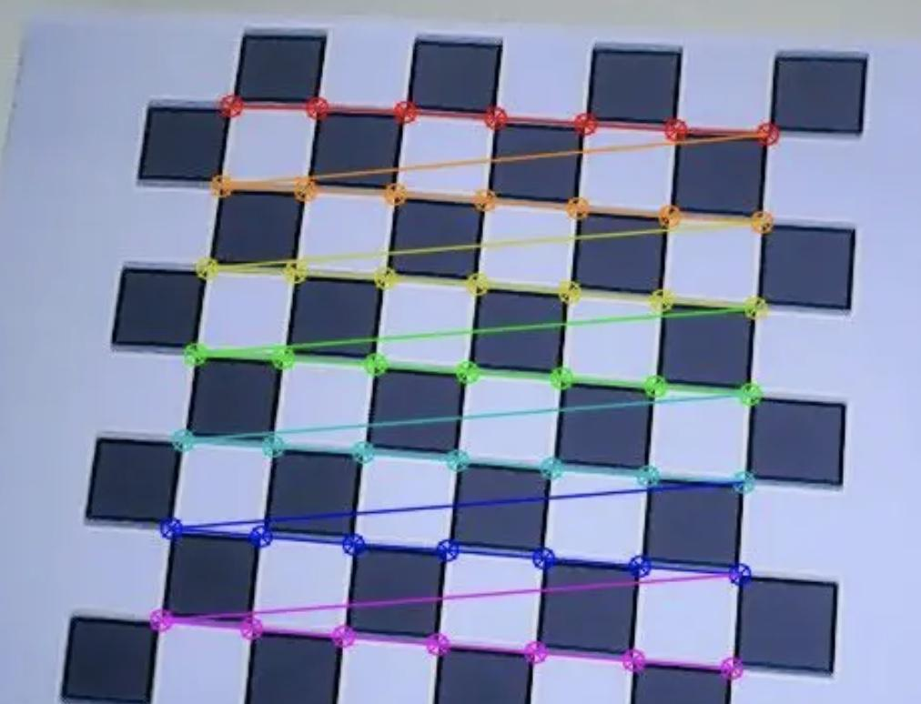
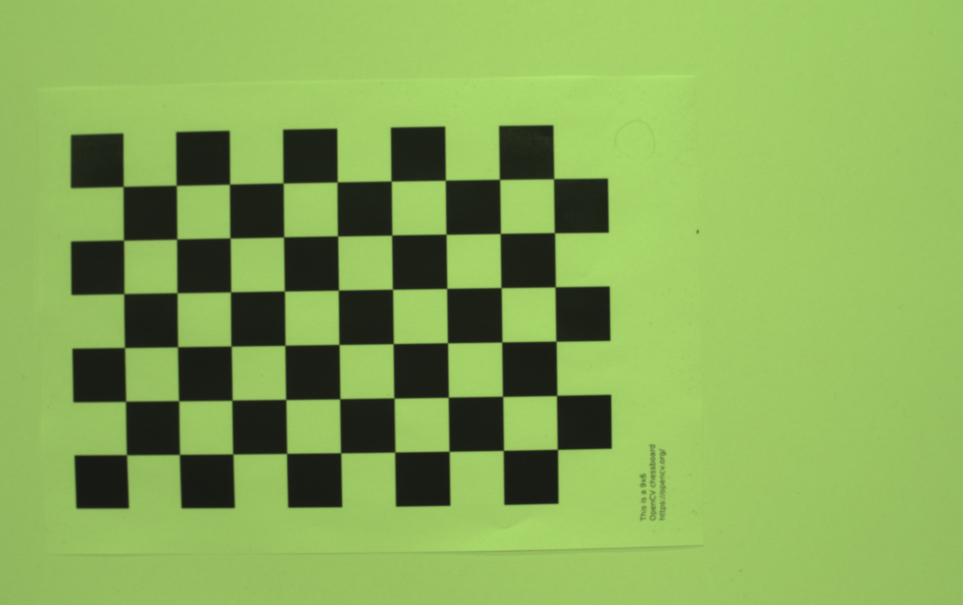
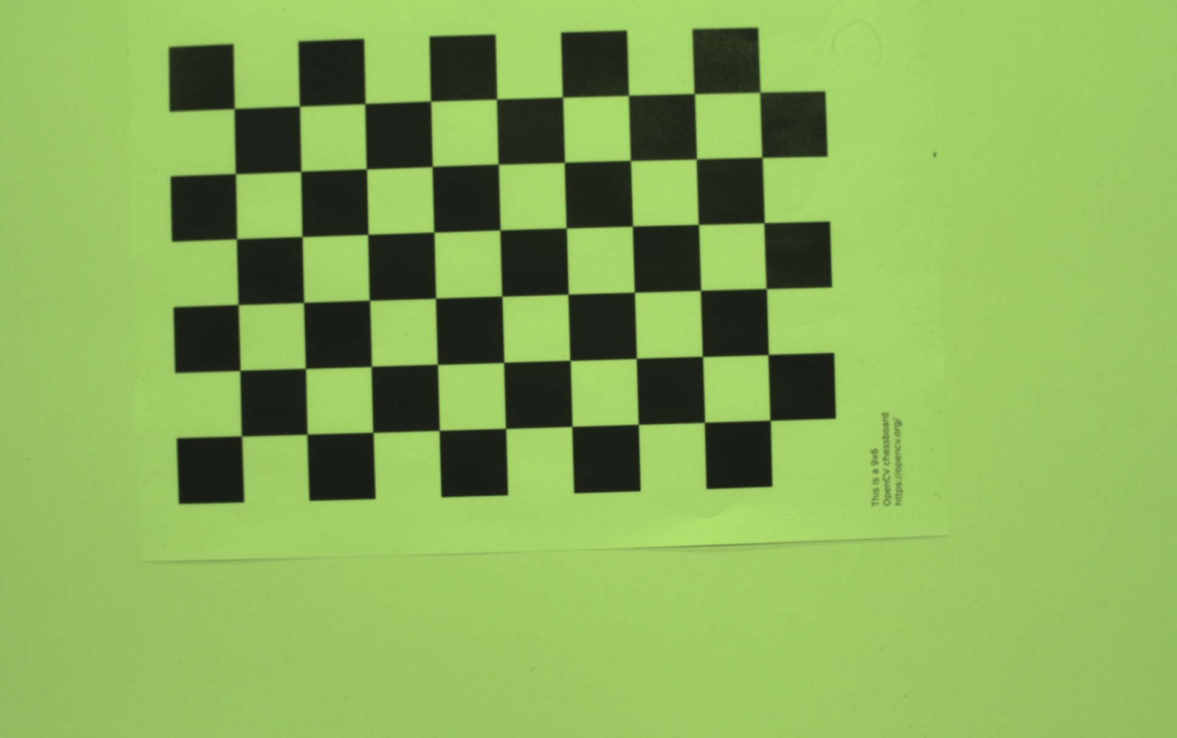
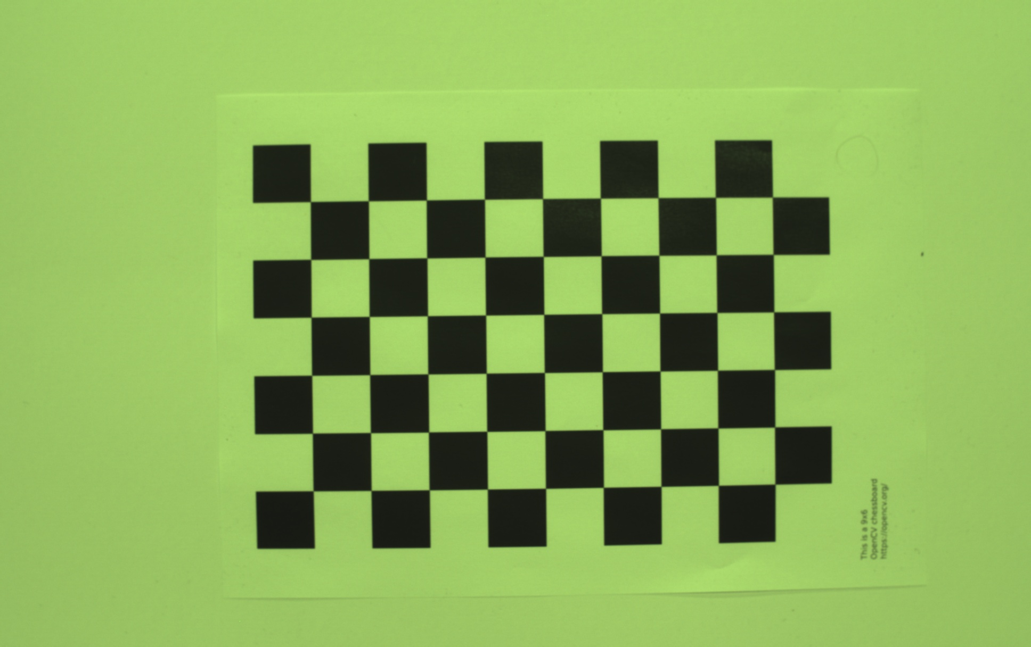
Algorithm - Camera Calibration
process of finding intrinsic and extrinsic parameters of camera
Intrinsic parameters - focal length, distortion, and principal point
Calibration of EVA Arm's Camera for better image quality

Slide 11

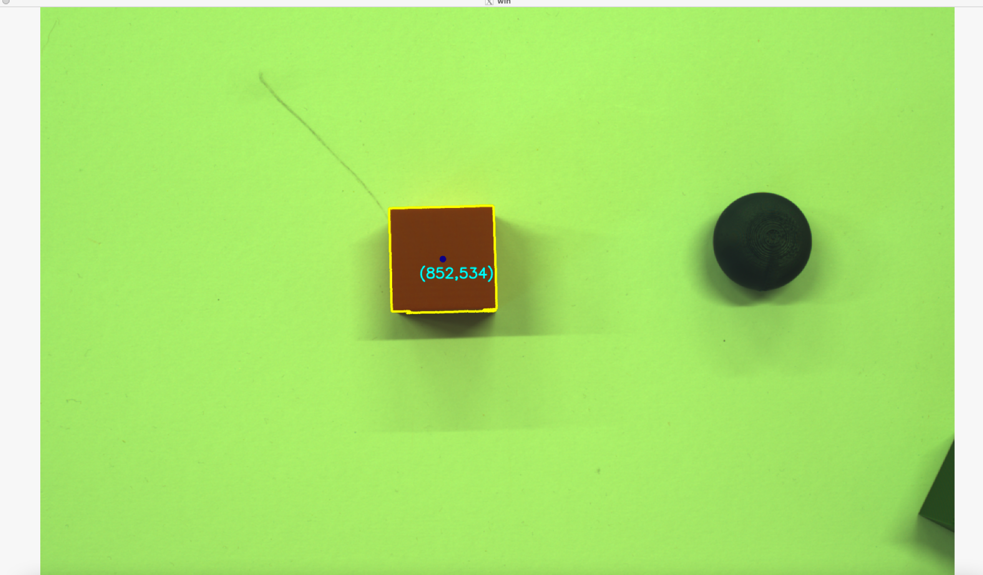
Algorithm - image recognition
1. Contour detection
2. Calculating the centre of mass of a contour
3. Remove duplicate contours
4. polygon approximation and classification of contours
5. vertex_count judgement(calc angles)
Photo by Pexels

Slide 12
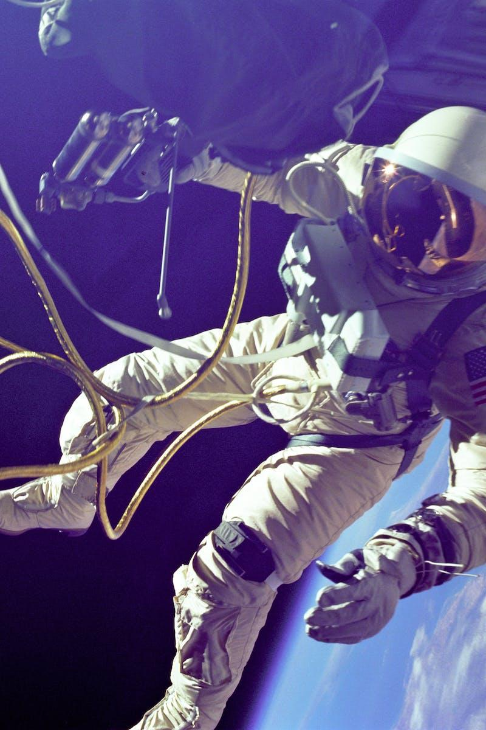
Algorithm - object distance
Capture an image or video of a known calibration object (such as a chessboard) from different angles using the camera that you want to calibrate.
Use OpenCV to detect the calibration object in the images and calculate its corners or other features.
Use the known dimensions of the calibration object (for example, the distance between the corners of the chessboard) to determine the pixel-to-meter ratio or other calibration factor for the camera.
Calculate the focal length of the camera lens using the formula: f = (P x D) / W, where P is the pixel-to-meter ratio, D is the distance from the camera to the calibration object, and W is the width of the calibration object in pixels.
Photo by Pexels

Slide 13
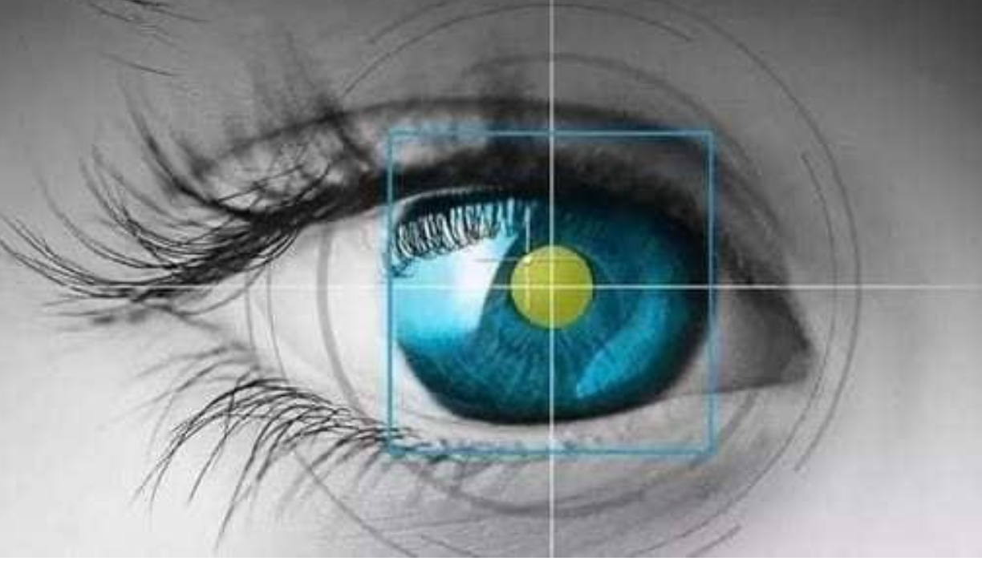
Algorithm - image pixel offset correction
By moving object to get the pixel difference
Calculate the real distance in previous step
Calculate the pixel-to-meter ratio
EVA ‘camera node’ tracing the central point of the object(using MSE to minimize the error)
High compensation for large spacing, low compensation for small spacing
Photo by Pexels

Slide 14

Algorithm - Tracing object
Moving object and calculating the offset of central point at the same time
Judging the offset signs to determine where to move (up, down, left, right)
Using inverse kinematics function to move to the offset coordinate
Photo by Pexels

Slide 15

Algorithm - Searching object
Simply move lock other joints and rotate one joint to draw a half circle to search target
If found, record current position and save to jocobian initial posture parameters
At last, executing main program(find target and catch it)
Photo by Pexels

Slide 16
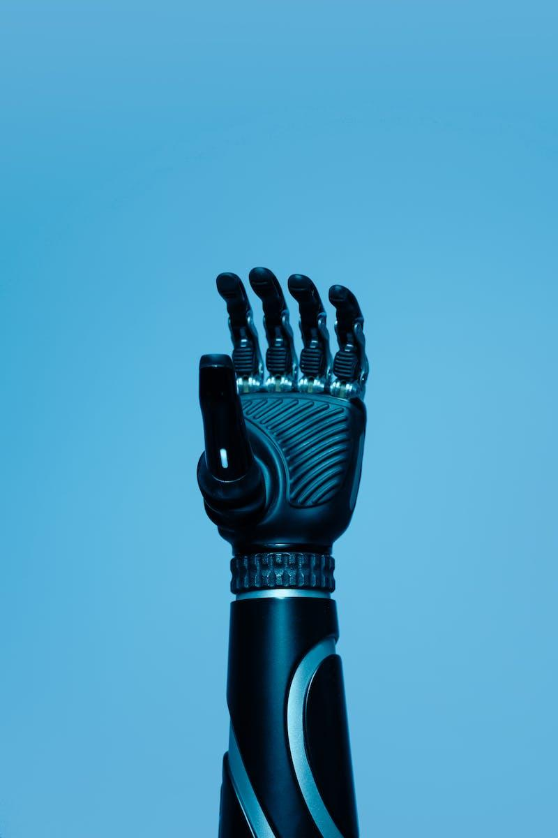
Algorithm - Kinematics
Forward Kinematics - finding end effector position and orientation
Finding DH Parameters and Joint Angles for Kinematic analysis
Finding Homogeneous Transformation Matrices for EVA Arm movement
Photo by Pexels

Slide 17
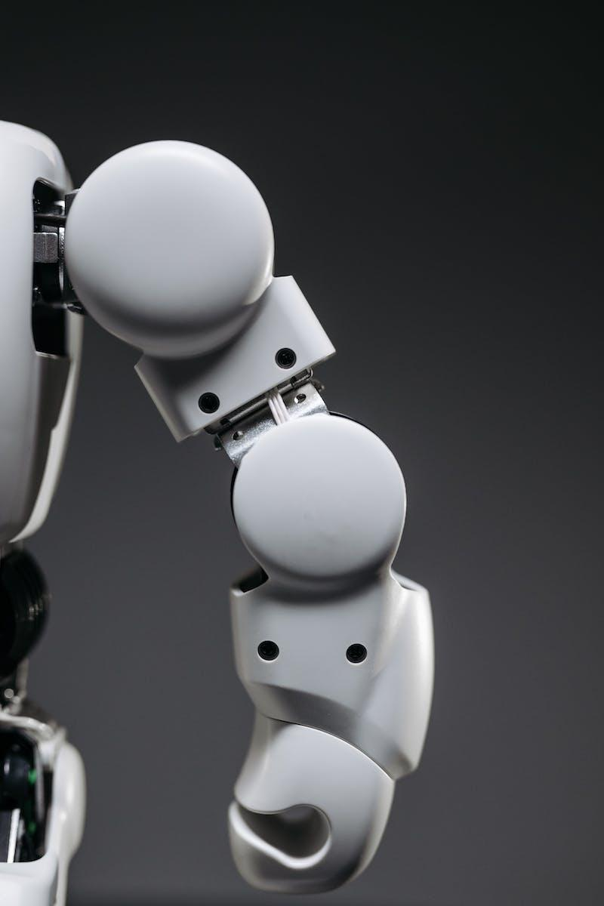
Algorithm - Inverse Kinematics
Figure out where you want the end-effector of the robot arm to go.
Use the Jacobian matrix to determine how much each joint of the robot arm needs to move in order to move the end-effector to the desired position.
Move the joints of the robot arm accordingly and repeat steps 1-2 until the end-effector reaches the desired position.
Photo by Pexels

Slide 18
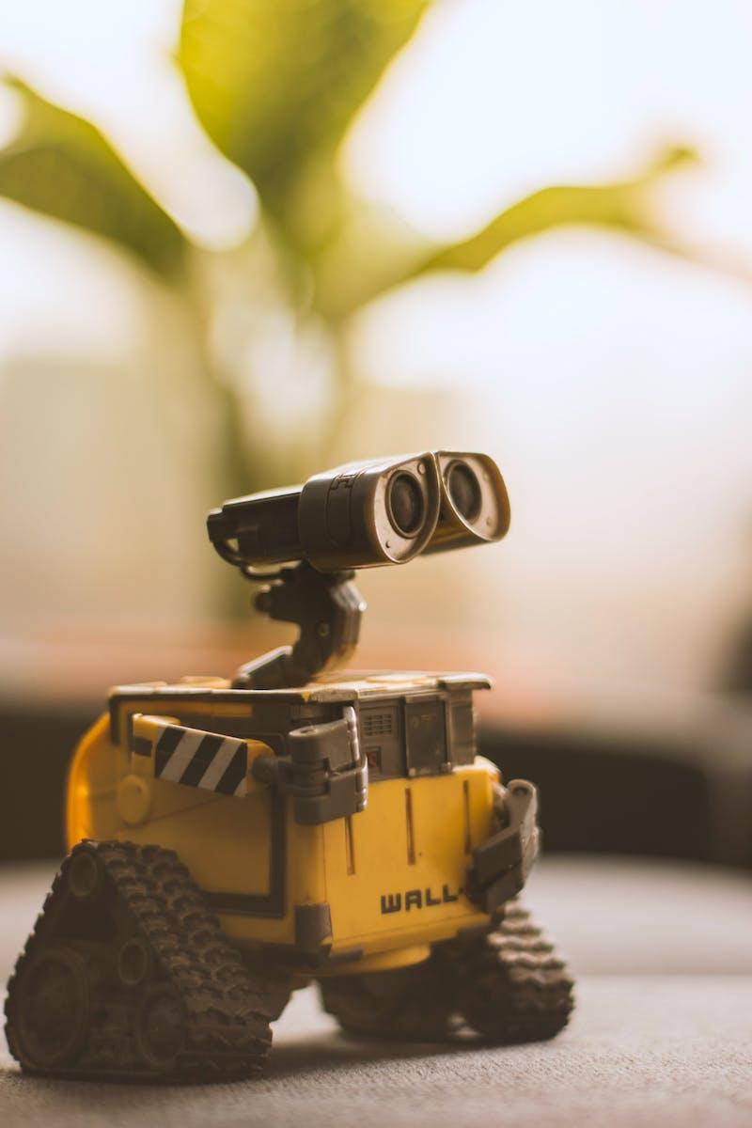
Algorithm - Trigonometric
Directly calculate each joint angles relationship with move distance, and build a formular
Use this formular to manipulate robot arms.
Photo by Pexels

Slide 19
Talk is cheap, show me the code! I’m gonna demonstrate 3 approaches including kinematics and reverse kinematics and other programming algorithm to reach the same goal.
And tracing algorithm.
Photo by Pexels

